Slide 1
PyCharm常用操作

Slide 2
reopen your PyCharm

Slide 3
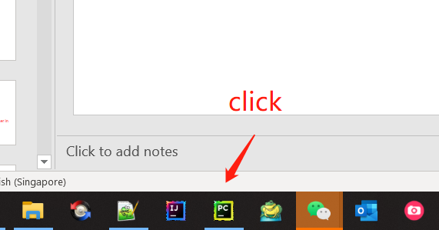
Click PyCharm icon in your PC task bar

Slide 4
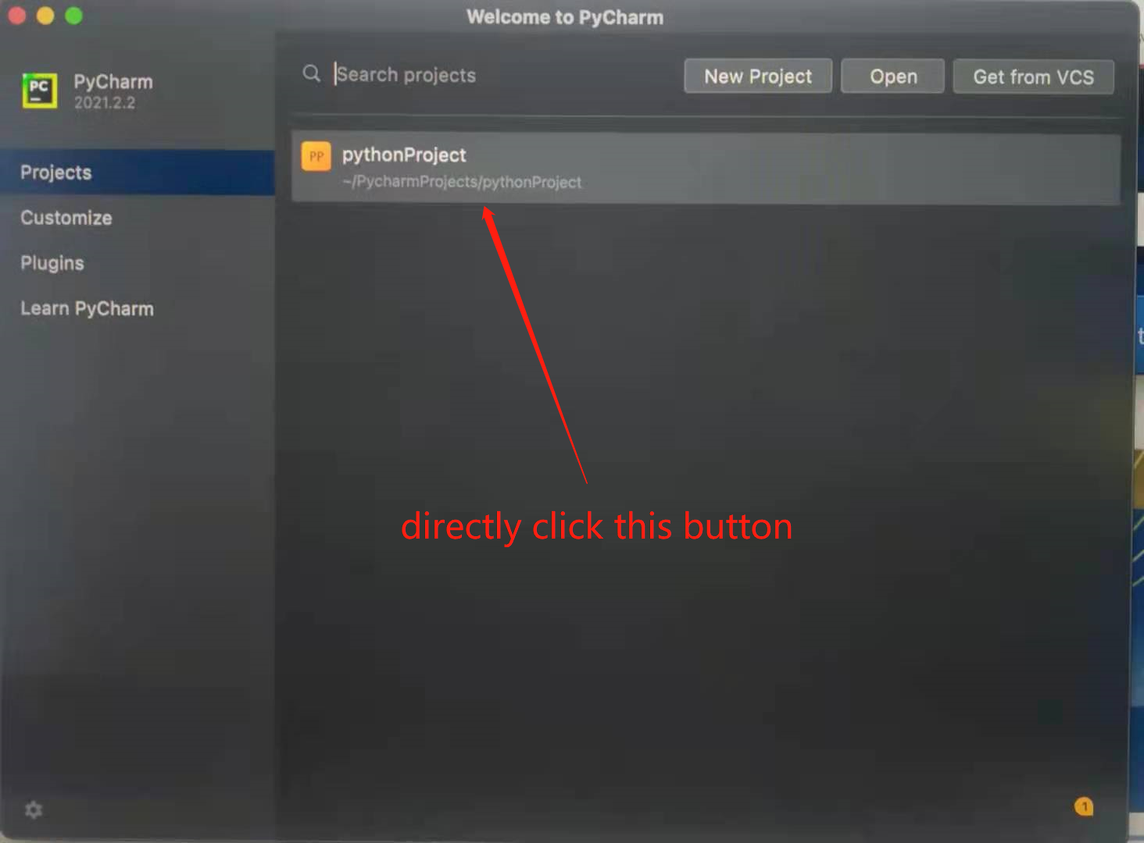
How to reopen your project?
直接点击黄色按钮
pythonProject

Slide 5
Create folder

Slide 6
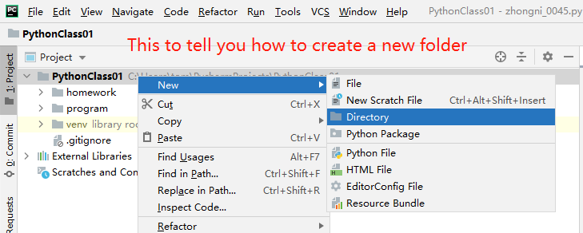
Right click on root project -> New -> Directory

Slide 7
Create Python file

Slide 8
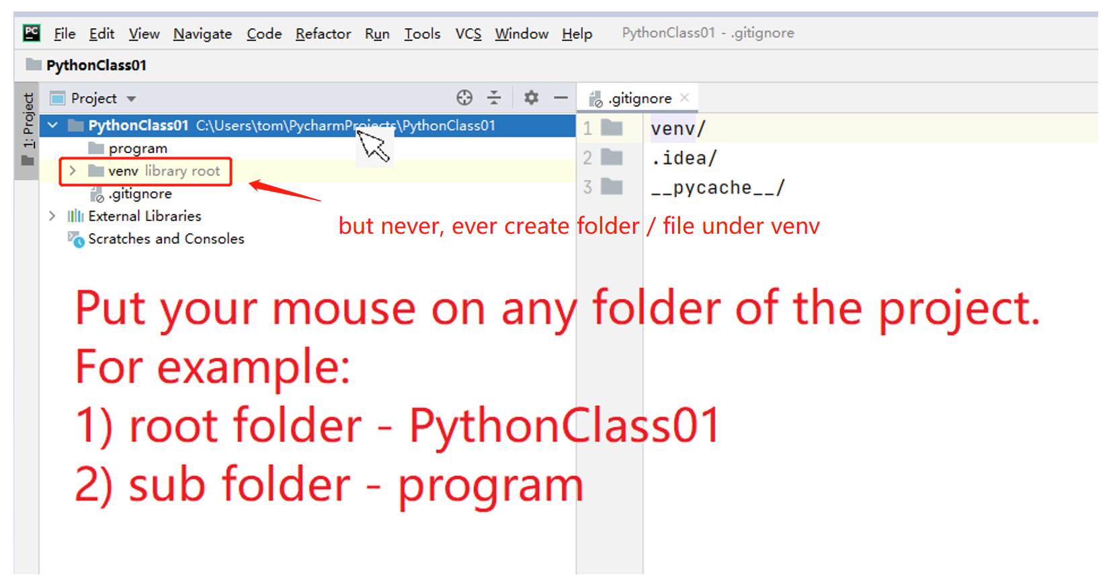
Create new Python File – Step 1)

Slide 9
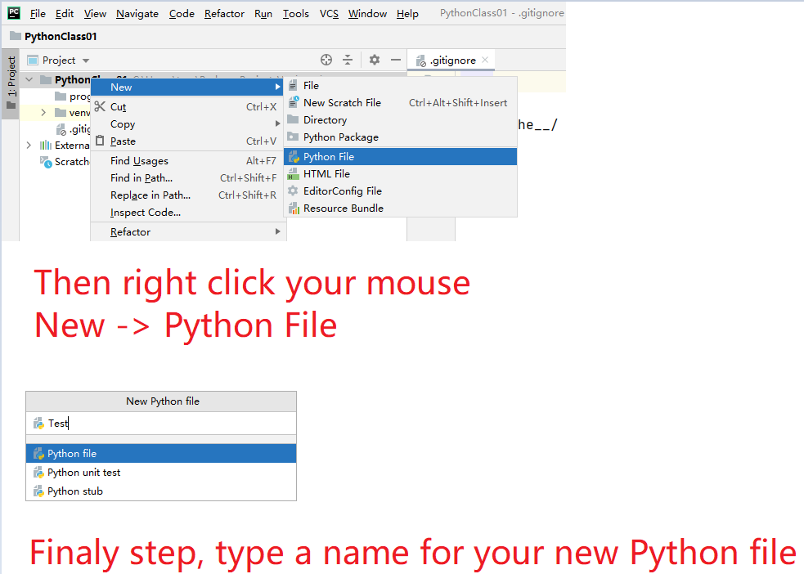
Create new Python File – Step 2)
If you use Mac
right click means
2 fingers press together in your mouse pad.

Slide 10
Run Python file

Slide 11
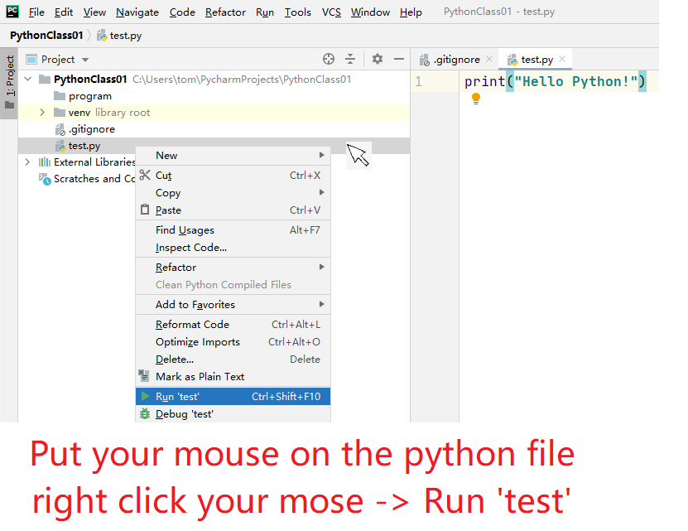
Run Python File

Slide 12
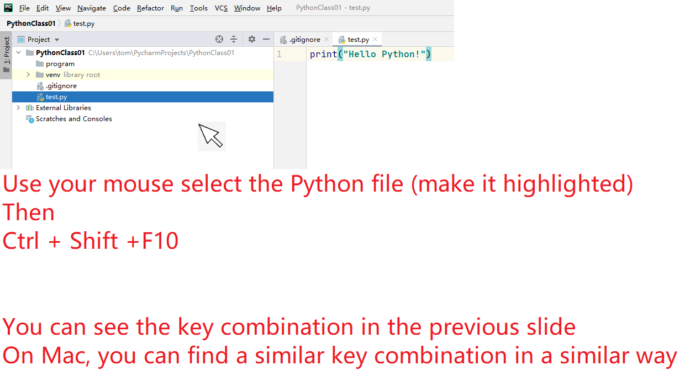
Run Python File – 2nd way

